Slide 1

Recognizing Handwritten Alphabets
-COMPUTER VISION PROJECT
Team:
Rohit Sahu
Ramya Sri

Slide 2

About Us:
Name: Rohit Sahu Name: Ramya Sri
Qualification: M.Sc. Electronics Qualification: B.tech
Work Experience: Fresher Work Experience: Fresher
As we live in a digital world, everything is data-driven. The demand for skilled data science practitioners in industry, academia, and government is rapidly growing and the job outlook for data scientists is very positive. It has great job opportunities in future.

Slide 3
Agenda
Problem Statement
Data Description
Project Life Cycle
Understanding the data
Data-Preprocessing
Exploratory Data Analysis
Visualization
Building the Models
Conclusions

Slide 4
Problem Statement
Recognizing the Handwritten Image Alphabets of MNIST data by using the ML Algorithms.
Analysis on the given data.
Comparison of various ML models.

Slide 5
Dataset Description
MNIST Data is the handwritten Alphabets(images) that are commonly used for the training various image preprocessing.
These dataset consist of 3,72,541handwritten images with the width and height of 28x28.
Image data is used for training and testing the data using the Algorithms.
These Image data is used for the predicting handwritten letters using the various ML
Libraries used:
PIL Library
NumPy
Pandas
Matplotlib
Seaborn

Slide 6
Project life cycle
Problem Statement
Data Pre-processing
EDA
Model Building
Evaluation

Slide 7
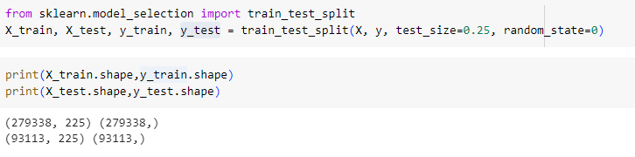
Data Preprocessing
Separating the Input and Output Variables.
Preparation of the Train and Test data with the train size of 75:25 split.
Building the model using the Classification Algorithms.
Data pre-processing is the second step of the project life cycle on image data. It involves cleaning, formatting, and transforming the data for analysis.

Slide 8
Data Preprocessing (continued)…
Checking the Properties of the images .
Resizing the Images using thumbnail in PIL library.
Converting to the NumPy array and converting to the 1D array using ravel().
Finally Converting it in to the data frame and uploaded into the drive.
Checking the Properties and some visualizations on the image data.
Initial size image data
28*28
Thumbnail
Final Size image
15*15

Slide 9
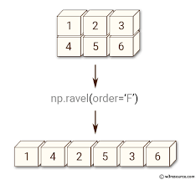
Converting to the NumPy array and converting to the 1D array using ravel().
Finally Converting it in to the data frame and uploaded into the drive.
Checking the Properties and some visualizations on the image data.

Slide 10
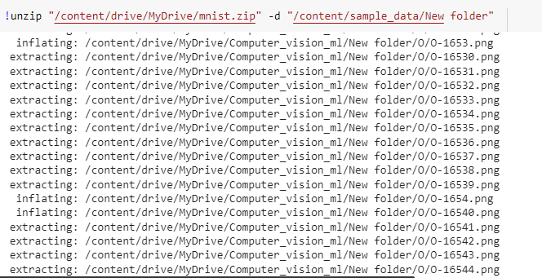
Exploratory Data Analysis
First unzipping the data in the google colab .
Reading the unzip files and using PIL library .
Checking the Properties of the images .
Checking The duplicates
Checking for the variation of the data.

Slide 11
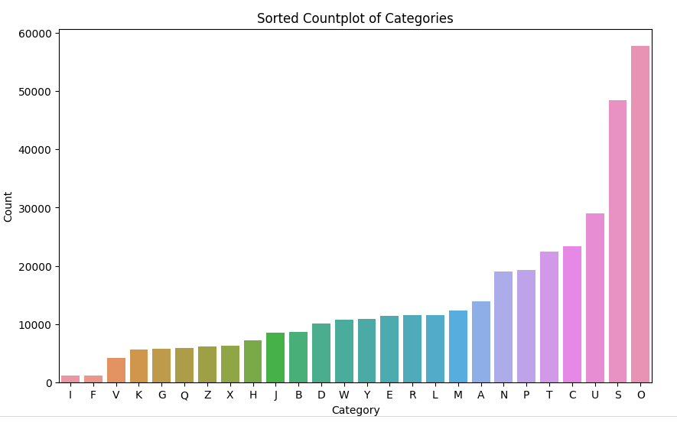
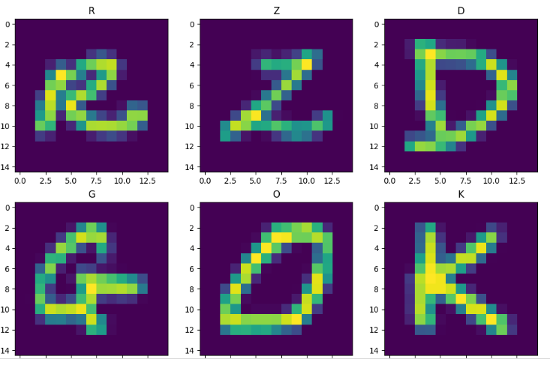
Visualization
Displays the Count of the each alphabet characters in the given MNIST Image dataset.
These are some random handwritten character in dataset

Slide 12
Building the Model Using Machine Learning Algorithms
Trained the data using the ALGORITHM by passing the X_Train and y_train to it and it will Build the Model.
Predicting the Handwritten Images by Passing the to the Generated Model and it will Predict the image. y_test
By using Evaluation metrics for the Classification generated the accuracy score for it.

Slide 13
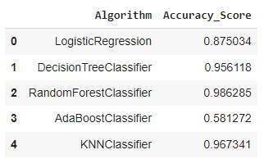
Evaluating the Model
Evaluation metrics used for these model is accuracy score.
Results:
Accuracy score is used for the all algorithms to evaluate the model.

Slide 14
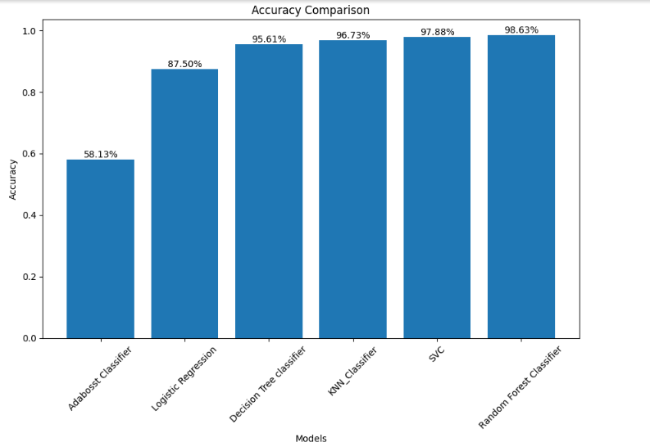
Conclusion
There is a high variation in the images of O and A alphabets i.e. O has the highest and A has the lowest
As we can see from the above observations Random forest Classifier and SV classifier gives the best results as compared to other algorithms
ADA boost Classifier gives the bad results
Best Algorithm: Random Forest classifier at 98.6% accuracy

Slide 15
Thank You

